Slide 1

PROJECT 2 Case Study 2
Ong Jung Yi 1006655
Luong Hung 1007160
Luvyn Sequeira 1007081
Stavya Sharma 1006995
Zhuang Yang Kun 1006933
Yee Jia Zhen 1006969
Lee Jun Hui Ryan 1006652

Slide 2
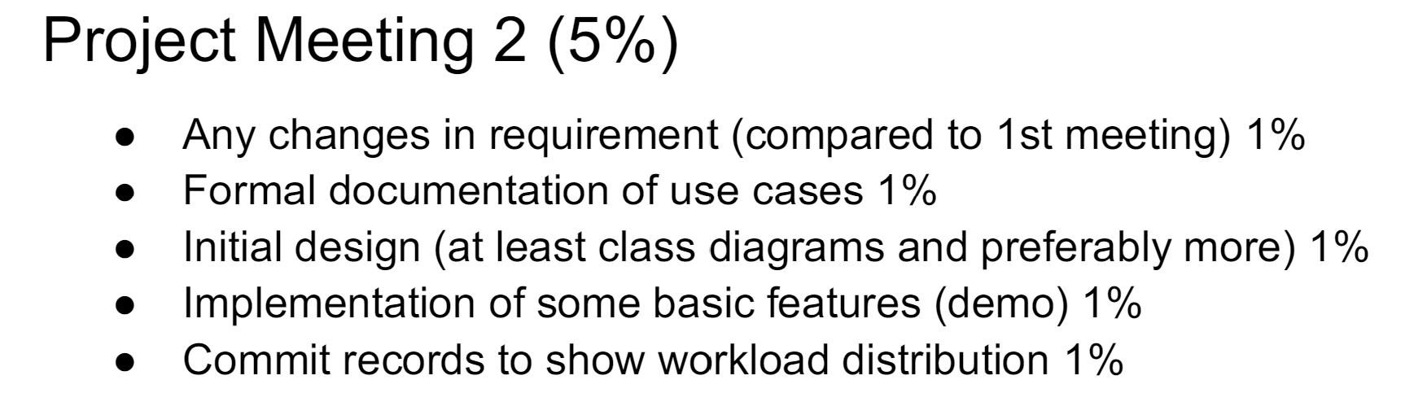
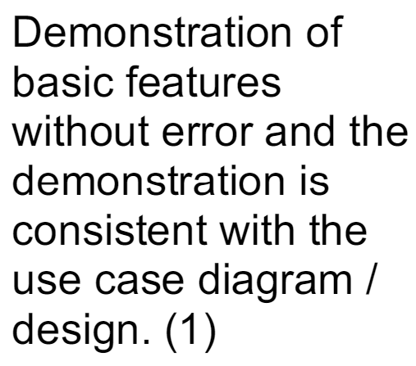
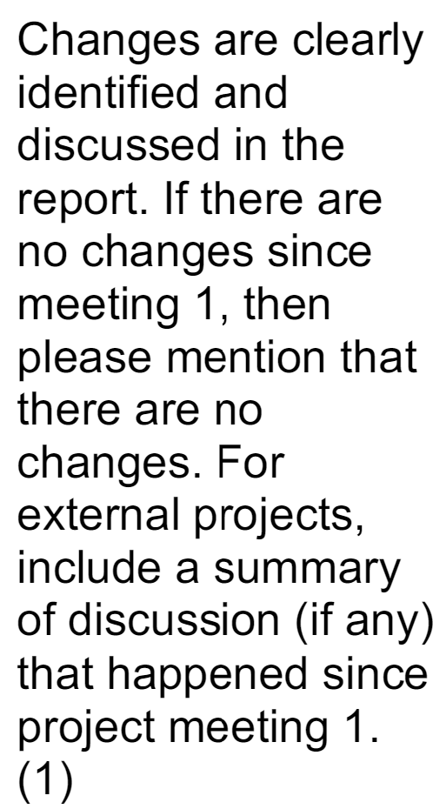
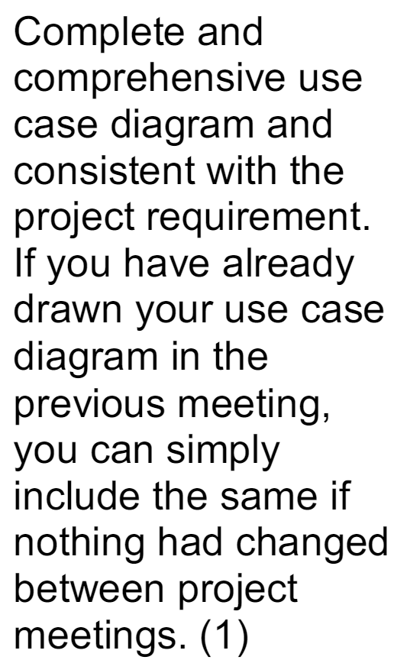
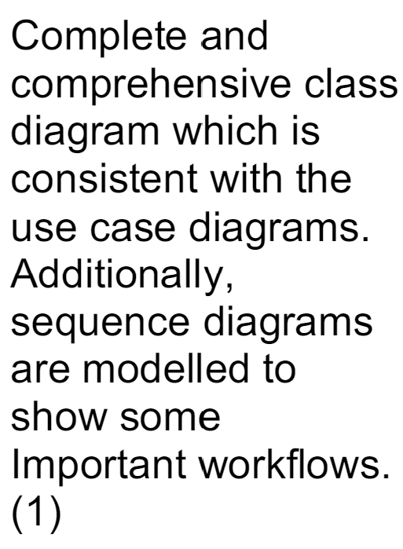
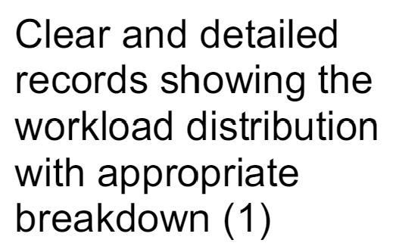

Slide 3
TABLE OF CONTENTS
01
02
03
04
05
ABOUT THE PROJECT
USE CASE (TECHNICAL)
RISKS & CONSTRAINTS
PROJECT TIMELINE
MEETING WITH CLIENT

Slide 4
01
ABOUT THE PROJECT

Slide 5



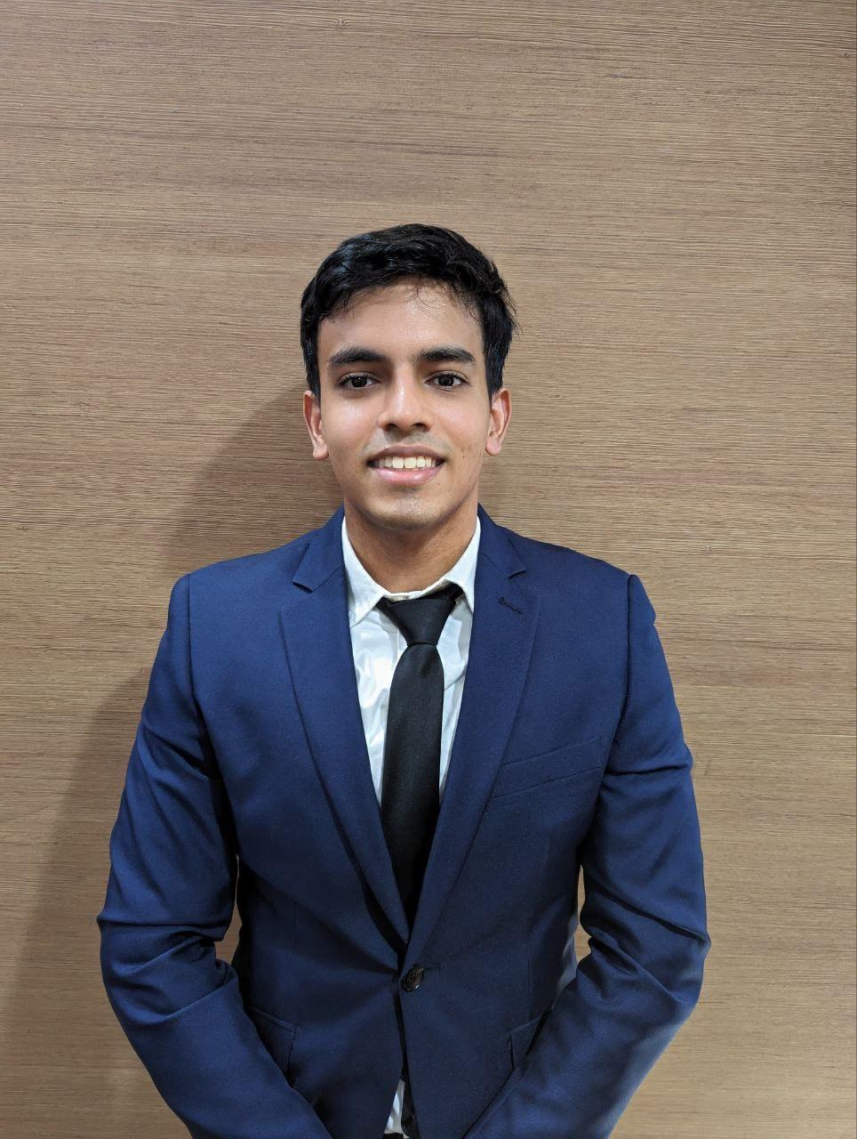


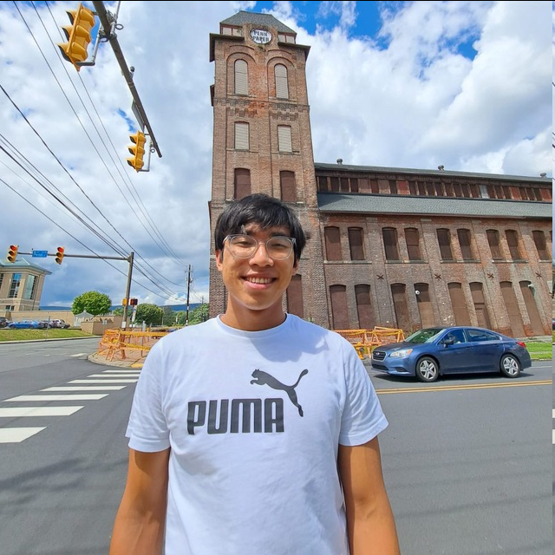
INTRODUCING THE TEAM
Yang Kun
Hung Luong
Jia Zhen
Luvyn
Ryan
Stavya
Jung yi

Slide 6
HOTEL BOOKING WEB APP - PURPOSE
Enables users to search, compare and book accommodations.
Contains aggregate listings from various hotels to display detailed information, user reviews and pricing.
Provide users with a user friendly platform to compare prices and book accommodation when travelling.

Slide 7
TARGET AUDIENCE
Leisure tourists, Business travellers, Families
Tech savvy individuals who prefer booking accommodations online & value the ability to compare prices
Budget conscious travellers looking for a seamless booking experience

Slide 8
WEB APP FUNCTIONS
FIND HOTEL
GET HOTEL DETAILS
SELECT DATE & TIME
ROOM TYPE
CHECKOUT & PAYMENT
BOOKING SUMMARY

Slide 9

PROBLEM STATEMENT
To create a functional and interactive hotel booking web app.

Slide 10
02
USE CASE (TECHNICAL)

Slide 11
USE CASE 1: Login
Description This use case enables customers to login to their Ascenda accounts before making a booking. While logging in is not required for booking, it provides additional convenience by autofilling the user’s details and preferences when making a booking.
Primary Actor Customer
Secondary Actor Authentication System, Database
Preconditions 1. Authentication System and Database is online
Postconditions 1. The customer is authenticated and is logged in to their account
Main Flow 1. Customer navigates to login page - system provides displays login form with username/email and password fields. 2. Customer enters their username/email and password and then submits login form. 3. System processes login request (checks credentials against stored user data) 4. Valid credentials - system authenticates customer and grants access to account 5. Customer is redirected back to main page but now logged in with session token

Slide 12
USE CASE 1: Login (alternative flow)
Alternative Flows 2a. Customer clicks on “Forgot Password” link 1. Customer redirected to password recovery page 2. Customer submits email for password recovery 3. System sends password reset link to provided email 3a. Customer does not fill up both fields 1. System displays a message informing user to fill up both fields 2. Return back to step 2 of main flow 4a. Credentials are invalid 1. System displays an error message indicating incorrect username/email 2. Return back to step 2 of main flow

Slide 13
USE CASE 2: Search
Description This use case allows the customer to perform a search using specified search criteria.
Primary Actor Customer
Secondary Actor System
Preconditions 1. Customer must be logged into the hotel booking system.
Postconditions 1. The user may click on search to view the search results.

Slide 14
USE CASE 2: Search
Main Flow 1. Customer logs into the hotel booking system. 2. Customer navigates to the search page. 3. Customer indicates relevant search criteria such as the dates of stay, country/region, number of guests etc. 4. Customer can click on the search button to display search results.
Alternative Flow 4a. Customer clicked on search button before entering mandatory search criteria such as country/region System prompts the user to fill the relevant search criteria. Customer fills in the relevant search criteria. Customer clicks on search button.

Slide 15
USE CASE 3: Display Search Result
Description This use case describes the process of displaying search results for hotels based on user input such as location,duration of stay and the number of guest
Primary Actor Customer
Secondary Actor Authentication System, Database
Preconditions 1. Customer has accessed the hotel search page on the website 2. Customer has inputted the necessary search criteria 3. System is connected to a database of the hotel API which provides the hotel data
Postconditions 1. Customer sees a lists of hotels that match the search criteria 2. Each hotel is displayed with a summarized version, including essential information such as hotel name, star rating etc…. Sorted by the prices 3. Customer can click on any hotel to view more detailed information and proceed with booking a room if interested

Slide 16
USE CASE 3: Display Search Result (Alternative Flow)
Main Flow 3. System processes search request 4. System calls an external API to retrieve hotel listing that match the search criteria 5. System sorts the search result by prices by default from lowest to highest 6. System displays the search results in a user-friendly format,showing essential information for each hotel 7. User interacts with the search result
Alternative Flows 1a. The user inputs invalid or incomplete search criteria the system will display an error message indicating the issue and prompt the user to correct it. 1b. If there is no hotels match the search criteria, the system will display a message indicating that no results are found and suggest modification of criteria 1c. System encounter a network issue, the system display an error message and allows the user to retry the search or try again later

Slide 17
USE CASE 4: Checkout Hotel
Description This use case enables customers to complete the checkout process for a hotel stay. The system processes the checkout details, calculates the final bill based on the duration of stay and any additional charges, and handles payment. The customer receives an email confirmation of their checkout and payment.
Primary Actor Customer
Secondary Actor System
Preconditions 1. Customer must have an active booking.
Postconditions 1. The hotel checkout is completed. 2. The payment is processed. 3. An email confirmation is sent to the customer.

Slide 18
USE CASE 4: Checkout Hotel (Alternative Flow)
Main Flow 1. Customer navigates to the checkout page. 2. System displays the total bill, including stay duration and any additional charges. 3. Customer reviews the bill and selects a payment method. 4. Customer completes the payment. 5. System confirms the checkout and sends an email confirmation to the customer.
Alternative Flows 2a. If the customer chooses not to log in, the system allows the customer to proceed as a guest. 3a. If there are discrepancies in the bill or errors during payment, the system prompts the customer to resolve the issues or try a different payment method. 4a. Customer requests an itemized bill to review detailed charges before final payment.

Slide 19
USE CASE 5: View Selected Hotel
Description This use case describes the process of user viewing their selected hotel from hotel search results.
Primary Actor Customer
Secondary Actor System
Preconditions Customer has searched for hotels.
Postconditions Customer sees the details of the selected hotel such as hotel name, star rating, price etc Customer can choose to proceed with booking the hotel.
Main Flow Customer clicks on a hotel from the search results. System calls an external API to retrieve the details of the selected hotel System displays the hotel details. User clicks book now to book the hotel.
Alternative Flows 4a. User click back to return to hotel search results. 1. Repeat steps 1 to 4

Slide 20
USE CASE 6: Payment Process
Description This use case describes the process of a customer making a payment for a hotel booking.
Primary Actor Customer
Secondary Actor System
Preconditions 1. Customer has selected a hotel and room. 2. System is connected to a payment gateway API. 3. Customer has valid payment information.
Postconditions 1. Payment is processed, and booking is confirmed. 2. Customer receives a booking confirmation. 3. In case of payment failure, customer is informed and can retry.

Slide 21
USE CASE 6: Payment Process
Main Flow 1. Customer reviews booking and proceeds to payment. 2. System displays payment options. 3. Customer enters payment details. 4. System validates details and processes payment via gateway API. 5. Payment is confirmed; system updates booking status and sends confirmation.
Alternative Flows 3a. If invalid payment details, system prompts for correct information, customer re-enters details. 3b. If payment failure, system informs customer of failure, customer retries or selects another method. 4a. If session timeout, system informs customer of timeout, customer restarts payment process.

Slide 22
USE CASE 7: Notify Users
Description This use case sends users an email confirmation to notify them of their successful checkout.
Primary Actor Customer
Secondary Actor System
Preconditions Customer successfully completes checkout of their hotel and payment has been processed.
Postconditions Customer sees the details of their booking such as the hotel name, duration of stay, type of room booked, etc.

Slide 23
USE CASE 7: Notify Users
Main Flow Customer logs into the system. Customer completes checkout of hotel. Payment gateway API completes processing the payment. System sends a notification email to the customer to provide them confirmation of their booking. Customer may click on a link in the email that directs them back to the booking website.
Alternative Flows 4a. System does not successfully deliver email to the customer due to email server being down. System logs this failure. System tries to send the email again at regular intervals until the email is successfully delivered to the user.

Slide 24
03
SOFTWARE DEVELOPMENT PROCESS & RISK ANALYSIS

Slide 25
DEVELOPMENT PROCESS: WATERFALL MODEL
Our team has decided to follow this order in our software development process: Project Planning, Analysis, Design, Implementation, Support
Project Planning where we understand the scope of the system and develop a timeline.
Analysis where we focus on understanding the business needs in detail with the help of software models.
Design where we design the solution system based on that.

Slide 26
DEVELOPMENT PROCESS: WATERFALL MODEL
Implementation phase where we will divide the different implementation tasks among members, and conduct integration and testing along the way.
Finally, we will conduct more testing and make any minor changes required before our final submission.

Slide 27
DEVELOPMENT PROCESS: AGILE METHODOLOGY
Iterative Development: Software is developed in small, incremental cycles (sprints) - appropriate for our team’s time schedule (where availability of time is inconsistent throughout the term)
Early and continuous delivery: appropriate for project requirements, which expects frequent project meetings

Slide 28
RISKS & CONSTRAINTS
Inadequate knowledge - team is new to JavaScript and web development
Mitigation: stick to tools and frameworks being taught in 50.003 (Node.js, Express.js, etc.) and reduce overhead that comes with learning new and unfamiliar tools (time, suboptimal code, etc.). Regularly consult professors and TAs for technical assistance.
Scalability - software might struggle with high volume of users
Mitigation: optimize database queries, scalable architecture design (services that can scale horizontally), regular load testing
Security - potential unauthorised access, data breaches, user personal data
Mitigation: good security practices (don’t save passwords directly, use hashes), implement role-based access control, only store necessary user data

Slide 29
RISKS & CONSTRAINTS
Maintenance - when system needs to be updated and maintained, might result in long periods of downtime
Mitigation: comprehensive documentation, modular design, keep system design simple
Time constraints - team has extremely busy schedule, tight on time
Mitigation: set out a project timeline (next slide) with sufficient buffer time. Implement only necessary features first. Optional features (like login system) can be developed if there is spare time, and software should be designed in a modular way such that optional features can be integrated easily (with minimal changes to existing code)

Slide 30
04
PROJECT TIMELINE

Slide 31
TIMELINE
WEEK 7
WEEK 8
WEEK 9
WEEK 10
- Planning Stage
- Figma Prototype
- Use Case Diagram
- App Structure
- Setting up Git repository (version control)
PROJECT MEETING 2
- Begin Coding
- Complete Basic Features
- Finalise Use Case Diagram & Design
- Demonstration of Basic Features
- Completion of Main Features
- Completion of Main Features

Slide 32
TIMELINE
WEEK 11
WEEK 12
WEEK 13
PROJECT MEETING 3
- Finalize any last changes to sequence / use case diagrams
- Completion of additional features
- Start unity & system testing
- Demonstration of all features & some tests
PROJECT MEETING 4
- Finalize features
- Finalize unit & system testing
- Complete project & handover
- Final Presentation

Slide 33
05
MEETING WITH CLIENT

Slide 34
MEETING WITH ASCENDAS
Introduced ourselves and the use case
Clarifications on project, expectations and deliverables
Informed that we are working on a React web app
Asked questions about the APIs & recommended web app design elements
Confirmed that official development workflow will be WATERFALL - Iterative & constant user feedback

Slide 35
THANK YOU!
Q&A

